Slide 1




MASTER PROGRAM IN
DATA SCIENCE AI & MACHINE LEARNING
www.mcta.co.in

Slide 2



Introduction to Machine Learning
www.mcta.co.in

Slide 3
Contents covered
1. Basics of Machine Learning
- Difference of Machine learning vs Programming
2. Phases in Machine Learning
- Train
- Test
- Validate
- Evaluate
3. Fields in Machine Learning
Data Mining
Statistical Learning
Data Science
AI
www.mcta.co.in

Slide 4
4. Types of Machine Learning
- Supervised
- Un-supervised
- Semi-supervised
5. Performance Metrics
- R-Squared
- MSE
- RMSE
- Confusion Matrix
- Accuracy
- Recall
- Precision
- Sensitivity
- ROC curve
- Entropy
Contents covered
www.mcta.co.in

Slide 5
Contents covered
6. ML Model optimization
- ML Model optimization
- Bias-Variance tradeoff
- Overfitting
- Underfitting
- Bootstrapping
- Cross-Validation
- Boosting
- Bagging
- Ensembling
7. SKLEARN Package
- Introduction to Usage of sci-kit learn package in Python
www.mcta.co.in

Slide 6
Basics of Machine learning
Difference between Machine learning and Programming
Programming | Machine Learning
It’s a process of writing computer applications like websites, games etc | Machine Learning is a process of finding patterns from data using statistical libraries
End to end logic is provided by the programmer / Author in form of computer language | Only the statistical formula is provided in form of libraries and rest of the logic is auto generated
Programming is a field that belongs to Computer Science | Machine Learning is a field that belongs to Artificial Intelligence
Examples of programming languages are Python, JAVA, C etc | Examples of Machine learning libraries include Naïve Bayes, Decision Tree, Support vector machine
www.mcta.co.in

Slide 7
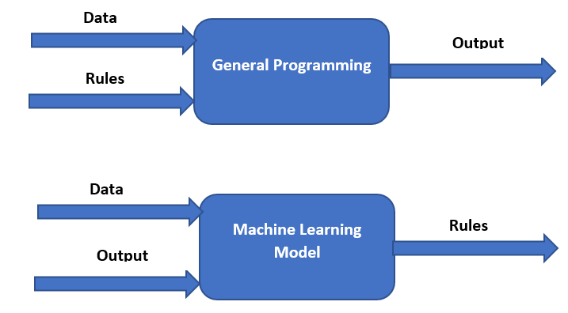
Basics of Machine learning
The following diagram further explains the logical procedures in
machine learning and programming
www.mcta.co.in

Slide 8
Phases in Machine Learning
Machine learning procedures are carried out in form of building statistical models
Consider applying Bayes theorem that we learnt in school but instead of using
a book and pen, we use Python/R programming language and have the computer
apply Bayes Theorem to our data
Such executions are carried out in 3 steps, train, test and evaluate
Step 1 – Train
The data is fed to the model and the statistical formula is applied in order to extract patterns
Step 2 – Test
Based on the patterns the model learnt in step 1, it is tested using new data on multiple samples
Step 3- Evaluate
Based on the accuracy score from testing phase in step 2, further improvements are made to the model
Like adding hyper parameters, removal of noisy data etc
www.mcta.co.in

Slide 9
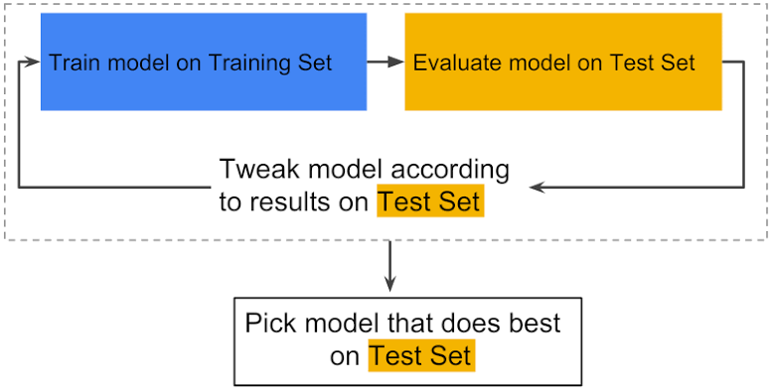
Phases in Machine Learning
The following diagram represents the process of train > test > evaluate
www.mcta.co.in

Slide 10
Fields in Machine learning
Machine learning has many fields that determines the scope of work, few prominent fields where machine learning is used is listed below with examples
Data Mining –
Procedure of extracting information from large datasets using statistical libraries, or querying databases (don’t confuse the term data mining for data gathering)
Statistical Learning –
Field of work that involves the use of statistical libraries to understand the patterns in data
Data Science –
Cross functional profile that involves the use of statistics, visual representation and programming to obtain knowledge from data
Artificial Intelligence –
The process of simulation of human intelligence by the computer is Artificial intelligence like a teaching a car to drive itself, or drone to avoid crashing into objects etc
www.mcta.co.in

Slide 11
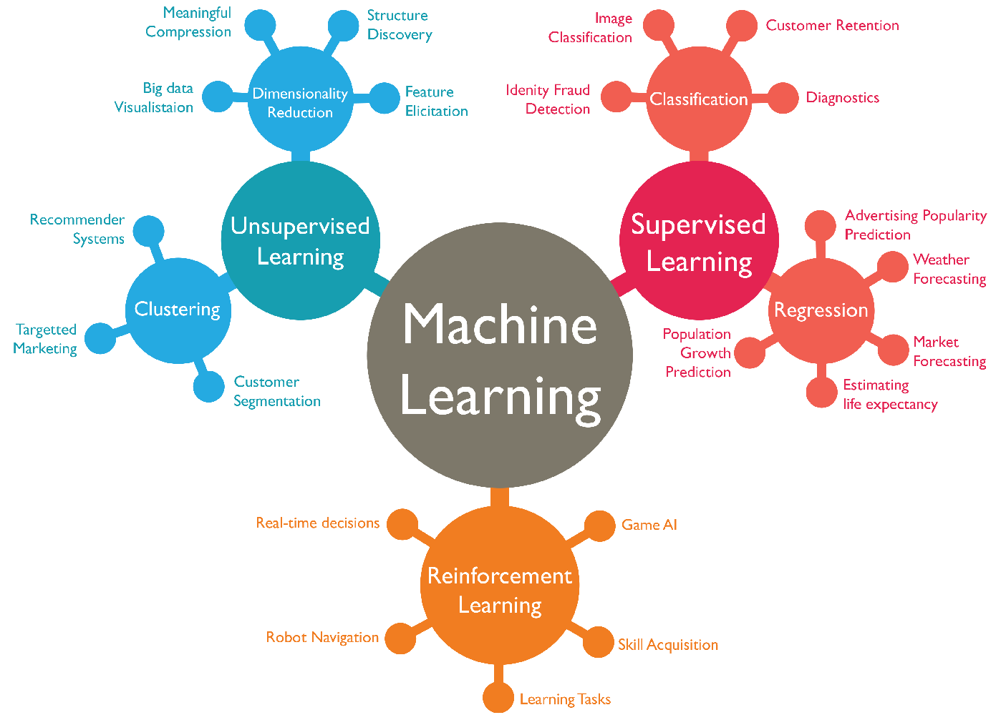

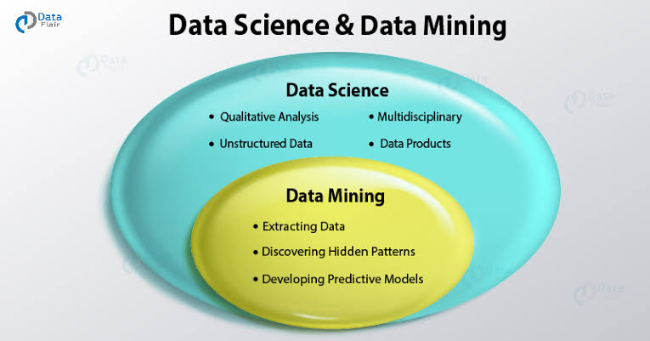
Phases in Machine learning
The following diagram lists Data mining, AI, Machine learning and statistical modelling
www.mcta.co.in

Slide 12
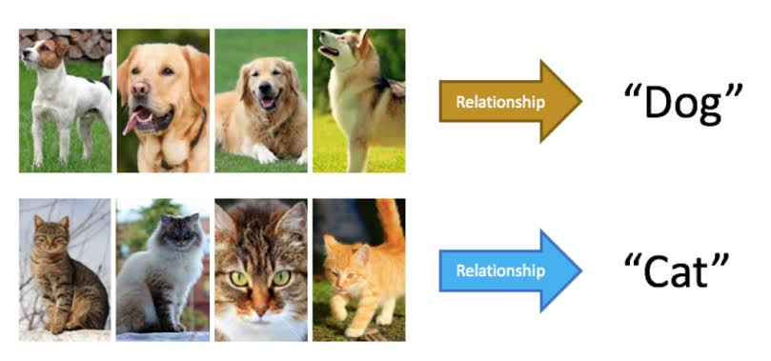
Types of Machine learning
There are several types of Machine Learning nowadays. However there are 3 prominent ones that are widely used such as Supervised learning, Unsupervised learning and Semi Supervised learning
Also there are other types such as reinforcement learning which we will park for later
Supervised Learning –
Model is fed with labelled data while training, for example if we are building a model that identifies if an animal is cat or a dog then the model will be trained using the images of cats and dogs
www.mcta.co.in

Slide 13
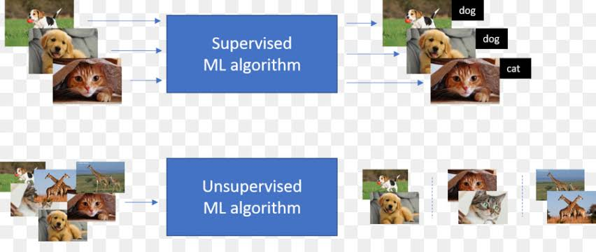
Types of Machine learning
Unsupervised learning –
Model is fed with unlabeled data and inferences are made using statistical techniques
For example, multiple images of cats and dogs will be fed to the model and based on the fact the dogs have bigger eye to ear ratio compared to the cats it can distinguish the animals
Again, here we wont give the model any labelled data unlike Supervised learning that will tell the model which pictures are of dogs or cats
www.mcta.co.in

Slide 14
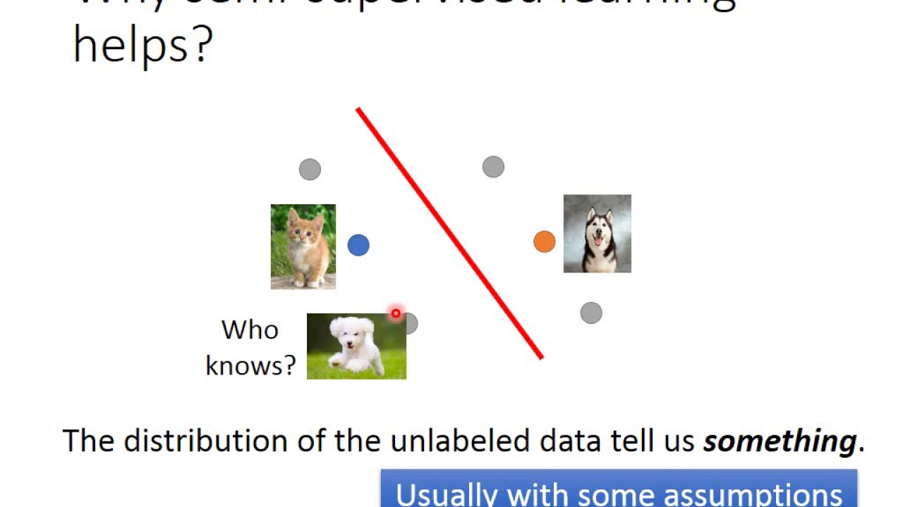
Types of Machine learning
Semi supervised –
A type of learning that involves training a model with small amount of labelled data and a large amount of unlabeled data
This practice falls between supervised and unsupervised learning
For example, which training the model to detect cats and dogs, the model is fed with some sample images stating which images are cats and which ones are dogs. Simultaneously its also fed unlabeled data that does not state if the animal is a cat or dog and based on the learning from labelled data the model is to distinguish between the 2 animals
www.mcta.co.in

Slide 15
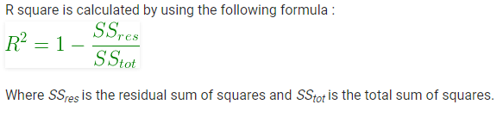
Performance Metric
There are multiple ways to check how precisely the model is working, we will discuss them one by one
R-squared (R²) –
Used in Regression models to detect how well the model is trained using training data
The desired value for r-squared is 1 and closer the value of r-squared to 1 the better
R-square is a comparison of residual sum of squares (SS_{res}) with total sum of squares(SS_{tot})
Total sum of squares is calculated by summation of squares of perpendicular distance between data points and the average line
Check the diagrams in next slide
www.mcta.co.in

Slide 16
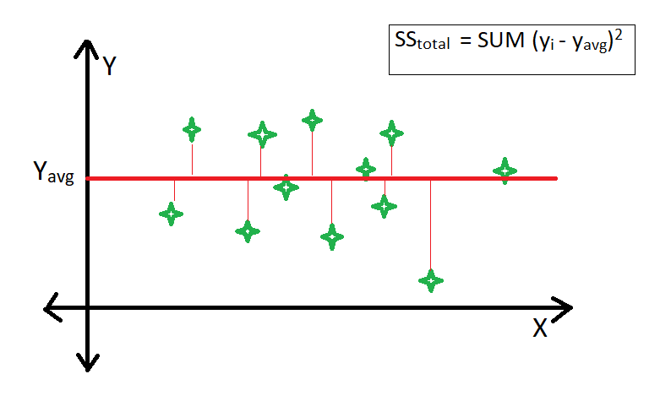
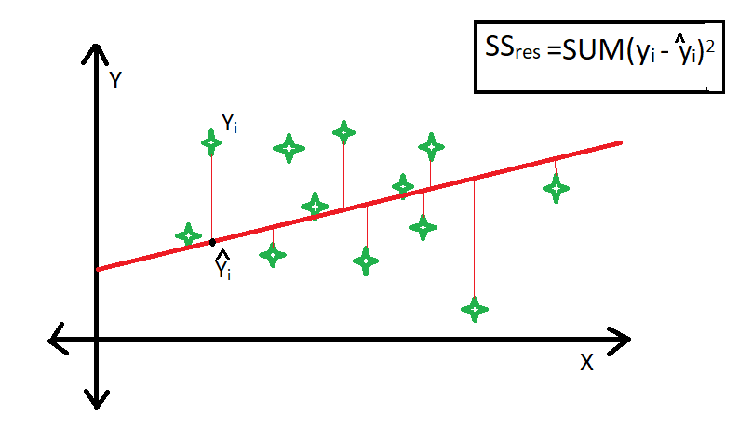
Performance Metric
Residual sum of squares in calculated by the summation of
squares of perpendicular distance between data points and the best fitted line.
www.mcta.co.in

Slide 17
Performance Metric
MSE (Mean Squared Error) –
Mean square error (MSE) tells you how close are any data points to the regression line.
The way its done is by taking the distance of the data points from a regression line and squaring it up. Squaring has 2 benefits, first it eliminates the negative values and second it gives more weight to the points that are too far from the regression line which makes it easier to spot them
(more about this when we cover linear regression)
For now consider we are trying to predict house price of 3 houses in Mumbai and we come up with the following values
House 1 = 41 Lac, House 2 = 41.5 Lac, House 3 = 43.2 Lac
Whereas the actual price of the house is
House 1 = 40Lac, House 2 = 44.3 Lac, House 3 = 49.9 Lac
www.mcta.co.in

Slide 18
Performance metric
Hence to calculate the MSE we need to subtract the actual price from the predicted for all houses, square them and then take an average like so -
House 1 >> 40 – 41 = (-1)^2 = 1
House 2 >> 44.3 – 41.5 = (2.8)^2 = 7.84
House 3 >> 49.9 – 43.2 = (6.7)^2 = 44.89
Then add all of them together
1 + 7.84 + 44.89 = 53.73
Then average them
17.91
So the mean squared error is (MSE) 17.91
www.mcta.co.in

Slide 19
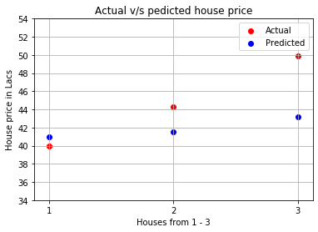
Performance metric
Root Mean Squared Error (RMSE) -
RMSE is just the square root of MSE. The square root is introduced to make scale of the errors to be the same as the scale of targets
Consider the previous house price prediction of 3 houses in Mumbai and we come up with the following values
House 1 = 41 Lac, House 2 = 41.5 Lac, House 3 = 43.2 Lac
Whereas the actual price of the house is
House 1 = 40Lac, House 2 = 44.3 Lac,
House 3 = 49.9 Lac
We got the MSE as 17.91.
Hence according the the definition,
RMSE is the square root of MSE,
hence RMSE for 17.91 = 4.23
www.mcta.co.in

Slide 20
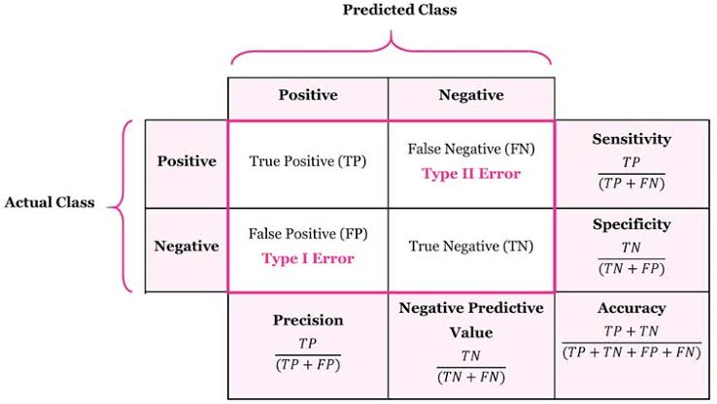
Performance metric
Confusion Matrix –
Confusion matrix is a table to evaluate performance of a given machine learning model
It has various information which tells us how accurate our model is performing for every given class
Few prominent measure in confusion matrix include Precision, Recall and F1 score
We shall discuss them individually in the forthcoming chapters
Below is the reference of a confusion matrix table
www.mcta.co.in

Slide 21
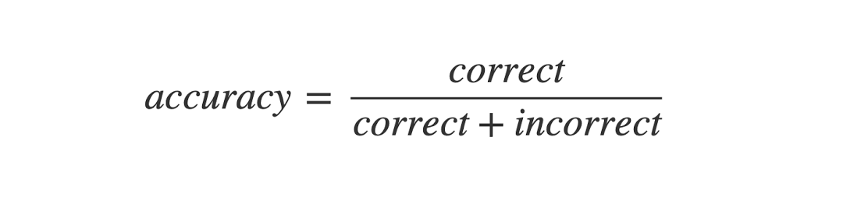
Performance metric
Accuracy –
Accuracy is the ratio of correct predictions in all examples used for testing. So, you tested your model on 100 examples (some of them are positives, some are negatives, the ratio doesn't matter). The model correctly predicted the label of 97 examples of those 100, so your accuracy is 97/100 = 0.97.
Below is the equation of accuracy
www.mcta.co.in

Slide 22
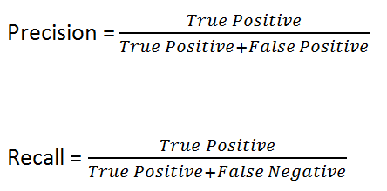
Performance metric
Precision –
Precision is a measure of accuracy on the labels of interest only. Often, the labels of interest are positive labels (i.e., spam), but it depends on the application. So, you tested your model on 100 examples. The model predicted as spam 80 of them, but only 60 of those 80 were correct predictions, so your precision is 60/80 = 0.75.
Below is the equation of Precision
www.mcta.co.in

Slide 23
Performance metric
Recall –
Recall is a measure of how many examples of interest your model has identified as such. Let's say you have 100 examples, you know that 70 of them are spam. Your model only predicted as spam 60 of those 70. So your recall is 60/70 = 0.86.
Recall is also known as Sensitivity
Below is the equation of Recall a
www.mcta.co.in

Slide 24
Performance metric
ROC Curve (Receiver Operating Characteristic Curve ) –
ROC Curve is a parameter for measure in classification problem that helps understand how well a model can distinguish between 2 classes, the higher the curve the better the model
Entropy –
Entropy is the certainty of a decision being correct or incorrect, the values is between 0 and 1 where 1 being True
www.mcta.co.in

Slide 25
Model optimisation
A machine learning model requires to be optimized in order to get better results
There are lot of methods that assist in optimization of a ML model, they are listed below
Bias-Variance tradeoff –
Lets divide this term,
Bias means assuming false results due to feeding of bad data to model, hight bias in a model means underfitting and the results will be bad in bith training and testing phase.
Variance is the measure of dispersion of data in the model (highly distinguishing data means more variance), high variance in the model means overfitting. Which means, the results in the training period will be good however while testing in unseen data, the model wont perform well
www.mcta.co.in

Slide 26
Model optimisation
Overfitting –
Overfitting means the model has memorized the pattern instead of generalizing it
This occurs due to high variance and the best way to deal with is usually by normalization of data and checking for imbalance
Underfitting –
Underfitting means the model isn’t able to grasp the pattern in the given data hence the model will perform badly during training and testing phases
Best way to overcome this situation is by adding more data and removal of noise from data
Bootstrapping –
Bootstrap aggregation or Bagging is a concept in ML where the data is resampled and fed to the model in order to ascertain that the accuracy remains constant on unseen data.
This decreases the variance and prevents overfitting
www.mcta.co.in

Slide 27
Model optimisation
Cross validation –
It’s a resampling technique where the model is tested on limited number of sample data to check its performance on data that was never used during training
Boosting –
Boosting is used to reduce the Bias in the model by combining weak learners with strong learners
Its does so by iteratively adjusting weights
Ensembling –
Ensembling is a procedure that combines multiple algorithm in order to get better results.
Boosting and Bagging are a form of emsembling techniques
www.mcta.co.in

Slide 28
Sklearn packages
Introduction to Usage of sci-kit learn package in Python
Sci-Kit learn is a package that is used in the field of machine learning which consists of various libraries.
These libraries are again bifurcated into various field of ML such as supervised learning, un-supervised learning, clustering, data preprocessing, performance matrix etc
More about it here
https://scikit-learn.org/
Check the Jupyter notebook (sklearn-intro) that demonstrates how various libraries are imported
www.mcta.co.in

Slide 29
Basics of Machine Learning
Trivia
Please solve the following questions
Q1) How is Machine Learning different from General programming
Q2) Is the following sequence correct Test – Train – Evaluate
Q3) What is data mining
Q4) What is supervised learning
Q5) Unsupervised learning is always trained with labelled data, is the following statement true ?
Q6) Define Artificial Intelligence (AI)
Q7) Define Accuracy
Q8) Define Recall
Q9) Sensitivity and Recall means the same thing, is the statement correct
Q10) What is ROC curve
www.mcta.co.in

Slide 30
Basics of Machine Learning
Trivia
Please solve the following questions
Q11) What is Bagging
Q12) What is Bias and Variance tradeoff
Q13) What is Boosting
Q14) What is Ensembling
www.mcta.co.in

Slide 31

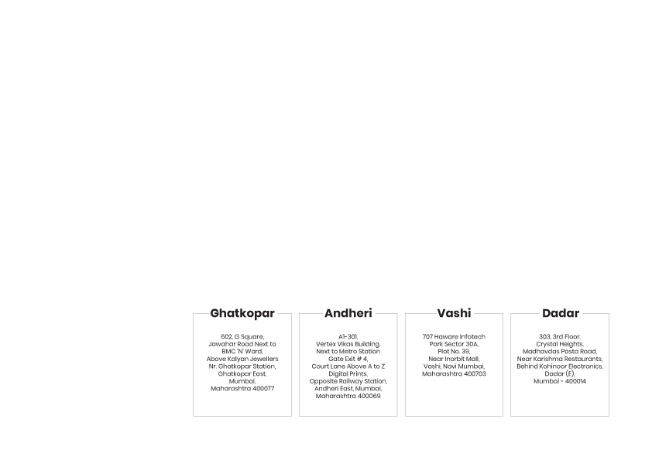
BE AN EXPERT DATA SCIENTIST!
www.mcta.co.in

